Slide 1
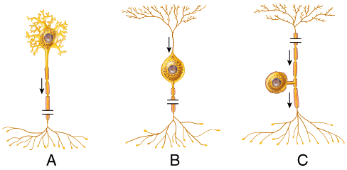
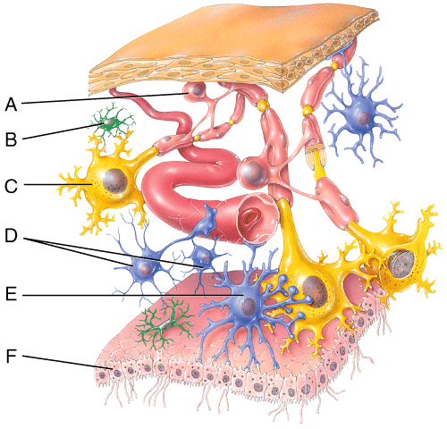
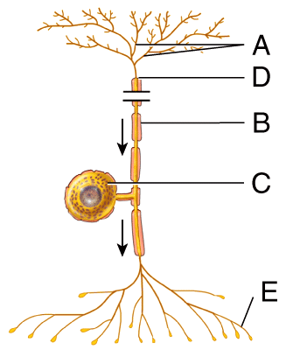
Image

Slide 2
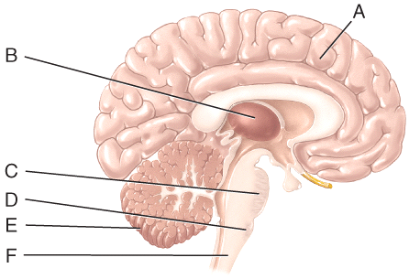
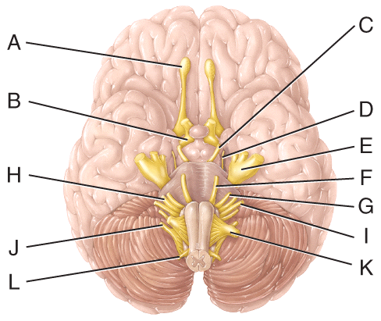

Slide 3
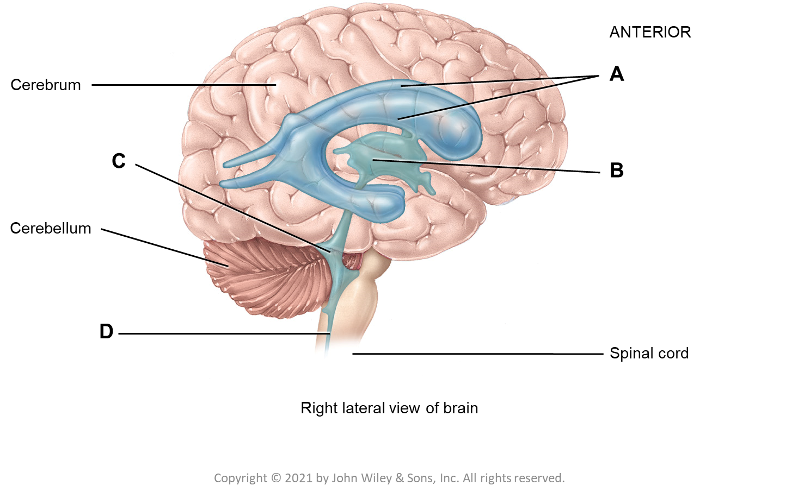
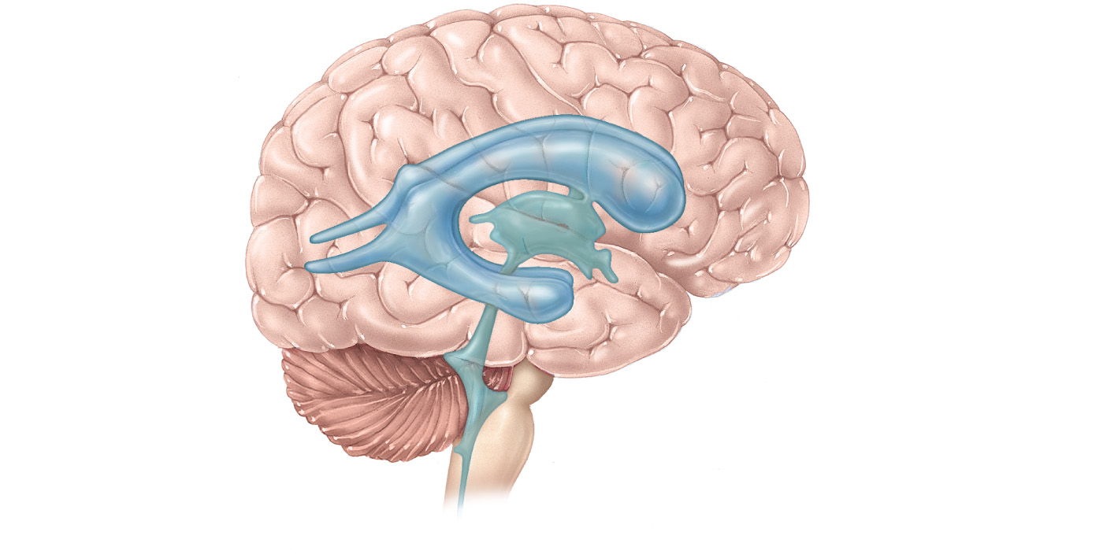
ANTERIOR
A
Cerebrum
C
B
Cerebellum
D
Spinal cord
Right lateral view of brain

Slide 4
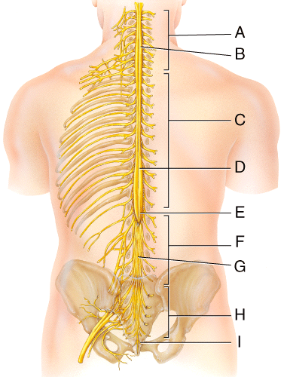
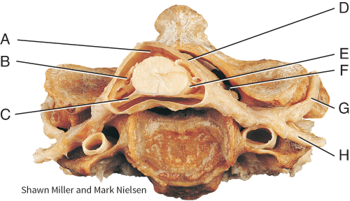
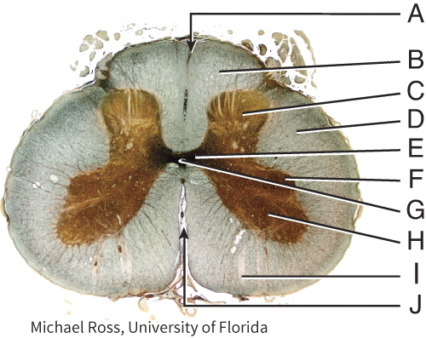

Slide 5
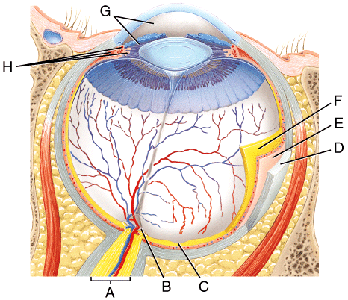
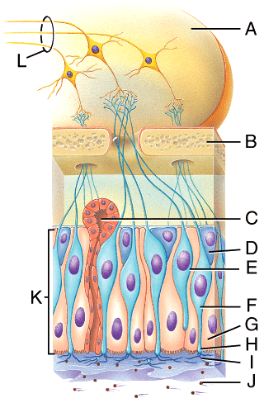
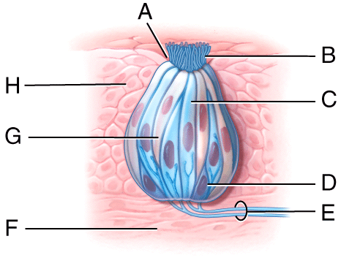

Slide 6
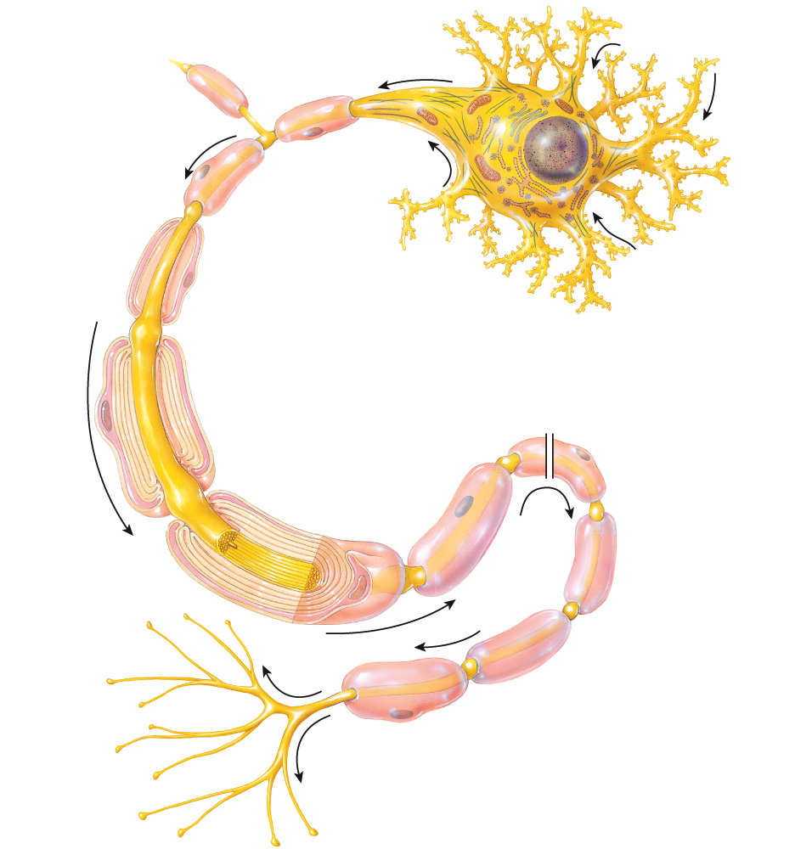
(branches)
(small bumps)
Axon collateral
Axon hillock
Axon
Nucleus
Nucleus of Schwann cell
Schwann cell:
Cytoplasm
Nerve impulse
Myelin sheath
Neurolemma
Myelin sheath gap
Neurofibril
Axon:
Axoplasm
Axolemma
Axon terminal
Synaptic end bulb
(a) Parts of a neuron

Slide 7
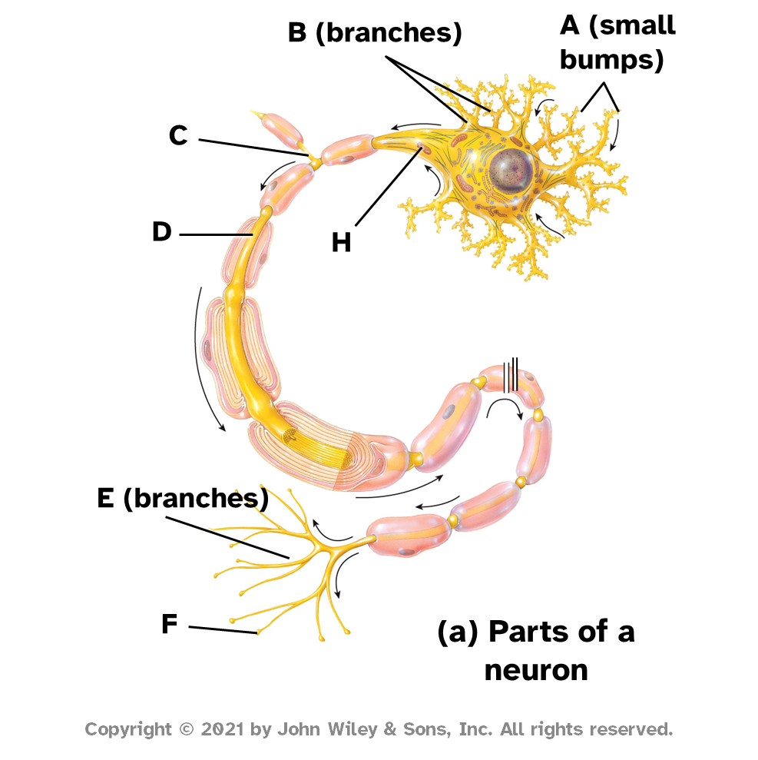
B (branches)
A (small bumps)
C
D
H
E (branches)
F
(a) Parts of a neuron

Slide 8
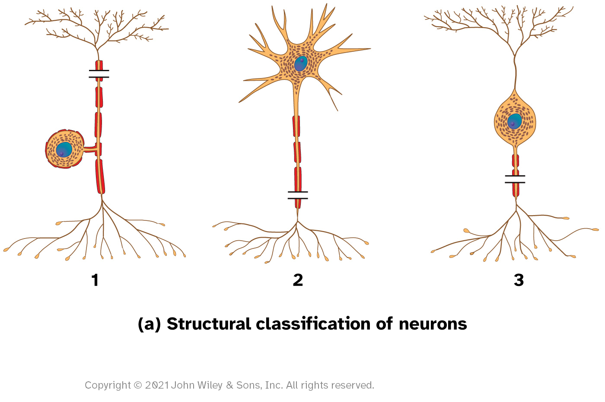
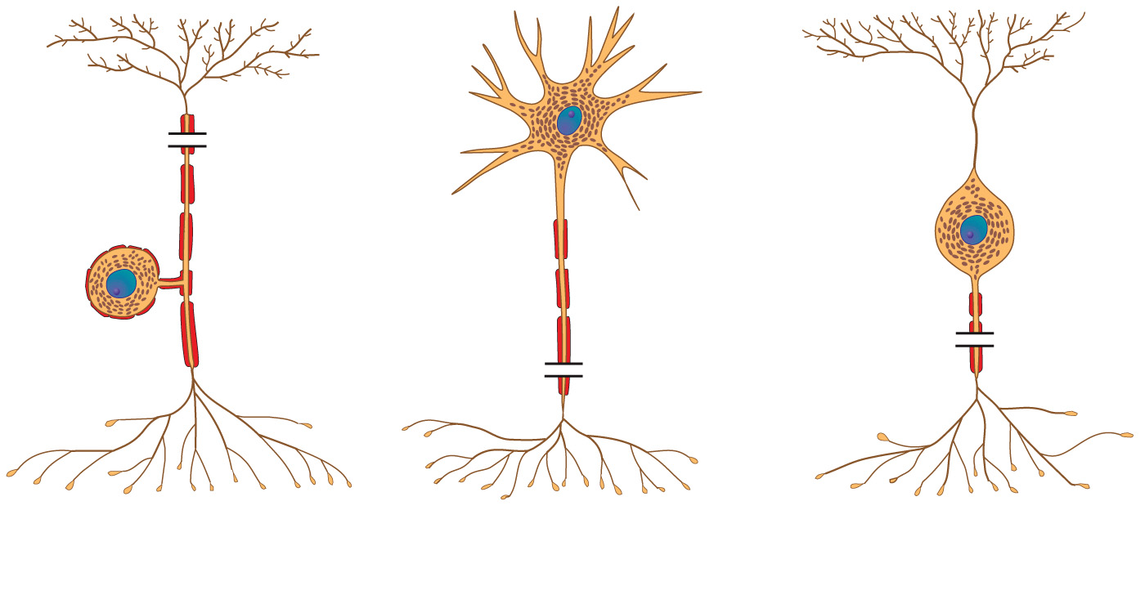
1
2
3
(a) Structural classification of neurons
Copyright © 2021 John Wiley & Sons, Inc. All rights reserved.

Slide 9
